Slide 1

OPEN RAN
Notes:
Today I am goin to talk about Open RAN, some of you especially those who are working for telecom vendors in their Cracov offices mightbe familiar with this topic but I am aware that it can be unknown for the others that’s why I suggest a following plan for today’s presentation

Slide 2
TABLE OF CONTENTS
01
02
03
INTRODUCTION
O-RAN EVOLUTION
RIC
04
05
O-RAN IN ACTION
SUMMARY
What is RAN? Why we need to make it more open?
Overview of the RAN history
RAN Intelligent Controller
Is that really works? O-RAN predictions and profitability
Accelerating the future

Slide 3

01
O-RAN Introduction

Slide 4
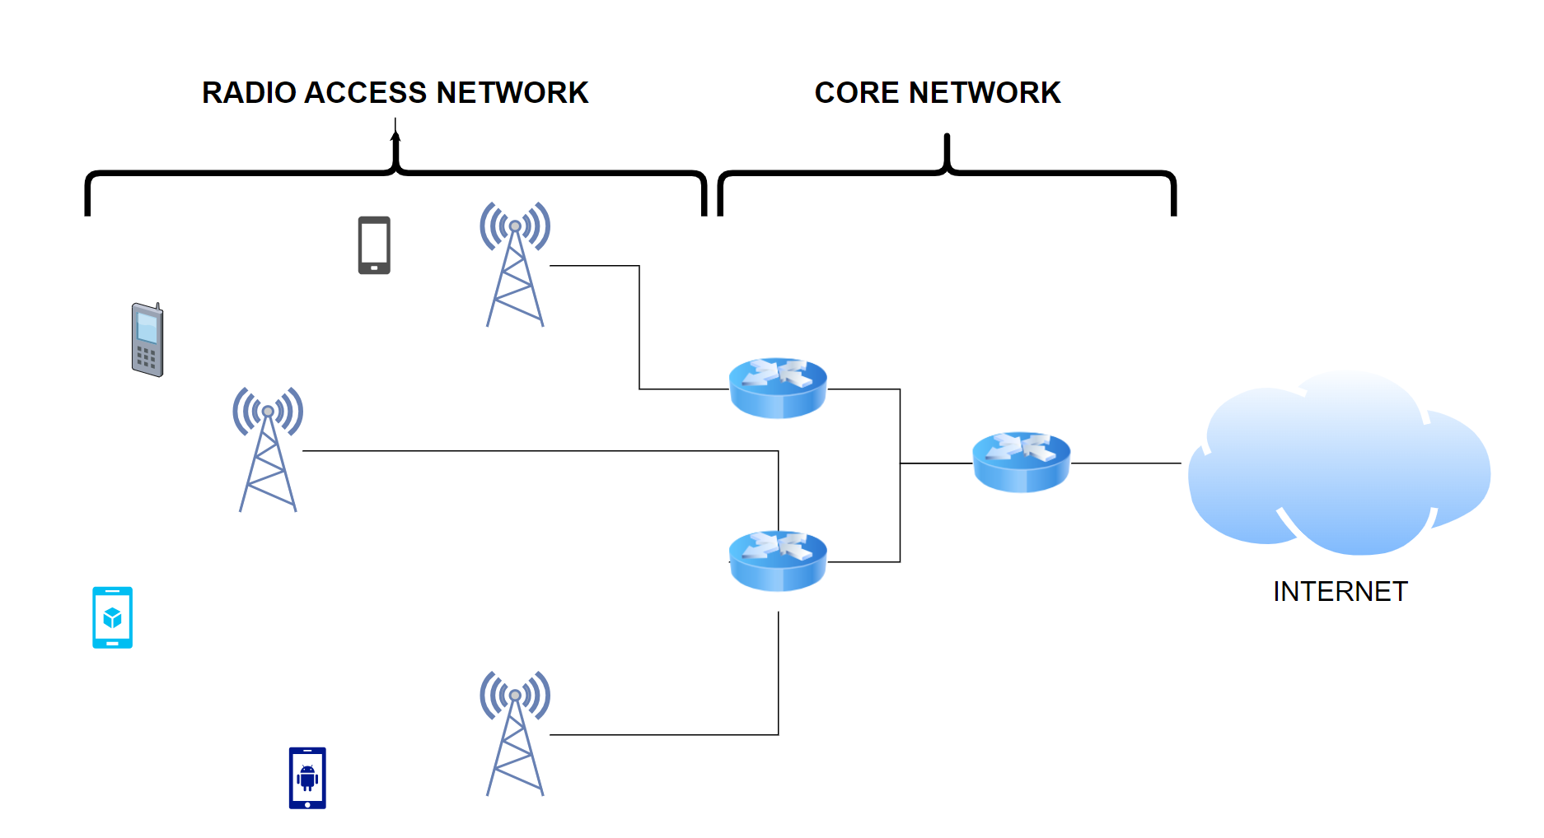

Radio Access Network
RAN
Major component of a wireless telecommunications system that connects individual devices to other parts of a network through a radio link
Antennas
Radio Units (RRU)
Baseband units (BBU)
Passive devices (Coupler, Combiners, Tappers, Splitters …)
Notes:
Explain the RAN and its components, zwroc uwage na vendor-lock in,
It all come us up from the one vendor that is limiting the telecoms in many areas (licences, their own ideas for network expansion, programmability and AI/ML based solutions) and these problems were addressed by O-RAN alliance found in 2018
Telecoms, companies from various IT sectors, R&D institutions, academic entities and standardization organizations. They are divided into workgroups responsible for specific areas and generally are providing specifications for the O-RAN architecture to help in Open RAN deployments.
All in all, Open RAN is for enhancing telecoms efficiency by breaking the vendor-lock in barrier and enabling them to use multi vendor solutions

Slide 5
WHAT O-RAN DELIVERS TO USERS AND TELECOMS?
OPTIMIZATION
NEW EXPERIENCE
VENDOR DIVERSITY
STANDARIZATION
Programmable, intelligent and multi-vendor networks boost company competitiveness and creates new services for end-users
Software based solutions help operators to optimize their network investments (both CAPEX and OPEX) and be more eco-friendly
Telecoms are no longer limited by the vendor’s licences, politics or limitations
O-RAN Alliance delivers comprehensive specifications regarding the architecture and different aspects of O-RAN

Slide 6

02
O-RAN Evolution

Slide 7

OPEN RAN EVOLUTION
Single RAN
5G Open RAN Wave 1
5G Open RAN Wave 2de 1
Software is locked to hardware. Entire RAN must come from one vendor
Software is separated from hardware and may come from various vendors. However, sofware is bulkly and hardware is limited
Software is modular and broadly portable. Hardware is plentiful. Security mechanisms are imposed
Notes:
If we look deeply on the O-RAN history we might distinguish different phases of development for O-RAN

Slide 8

03
RIC – The O-RAN engine

Slide 9

RAN Intelligent Controller
Software-defined component of the Open Radio Access Network (Open RAN) architecture that’s responsible for controlling and optimizing RAN functions

Slide 10
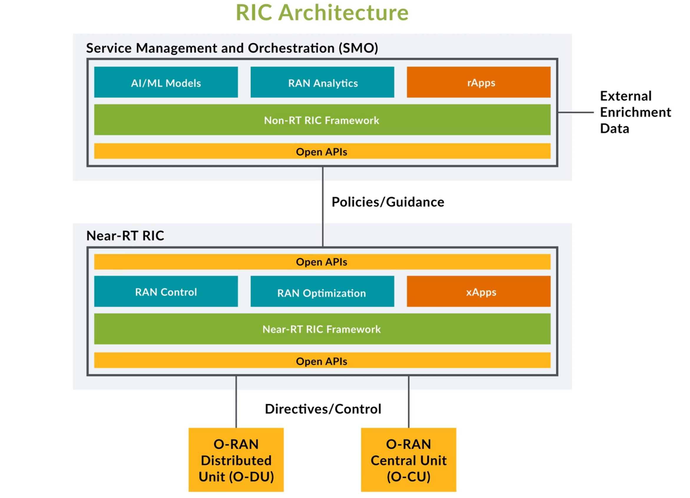
RIC Architecture
Non-RT RIC communicates with xApps running on a near-RT RIC to provide policy-based guidance for edge control of RAN elements and their resources
Near-RT RIC is responsible for intelligent edge control of RAN nodes and resources. It receives policy guidance from the non-RT RIC and provides policy feedback to the non-RT RIC through specialized applications called xApps

Slide 11

04
O-RAN in practice

Slide 12
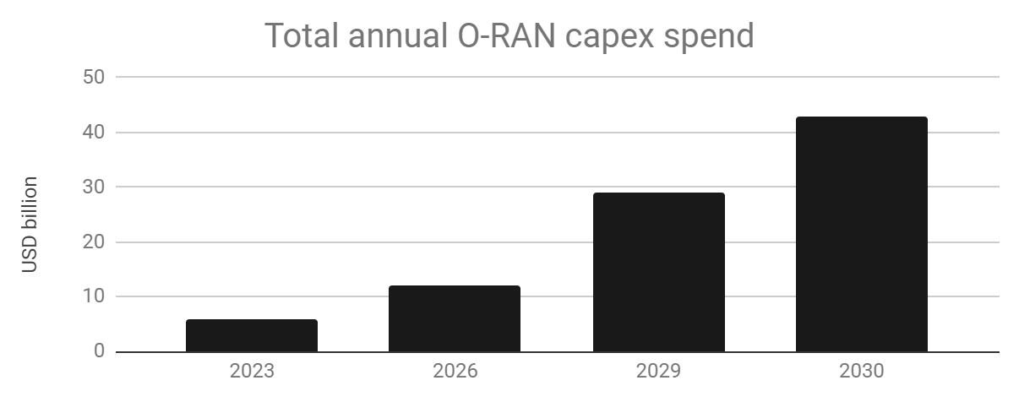
O-RAN in practice
O-RAN on chart
O-RAN Investments
Counterpoint Research Institute in its report Open RAN Tracker stated that investments in O-RAN will grow after 2025, and telcos will spend 30 bln dollars
in 2022-2030
O-RAN in media
O-RAN Predictions
Dell’Oro Institute in its report Open RAN Advanced Research Report stated that RAN market will consist in 2026 in 15% of Open RAN-based solutions

Slide 13
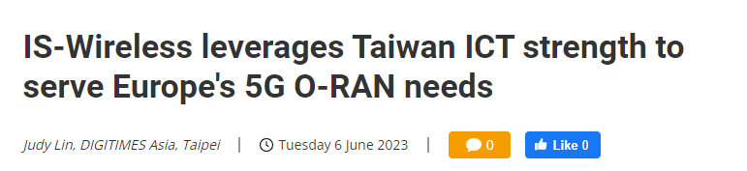
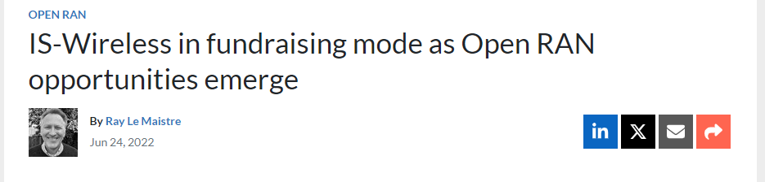
Polish commitment in Open RAN
IS-Wireless (Headquartered in Piaseczno)
The company has been recognized as one of a few European O-RAN vendors by leading telco operators including Deutsche Telekom, Orange and Telecom Italia (TIM)
IS-Wireless is one of Europe’s Open RAN specialists
The Poland-based vendor has developed software for fully virtualised RAN deployments
It has some near-term opportunities in private networks

Slide 14

05
SUMMARY
A good hockey player plays where the puck is. A great hockey player plays where the puck is going to be.
Wayne Gretzky

Slide 15

THANKS
Does anyone have any questions?

Slide 16
Bibliography
https://www.telko.in/inwestycje-w-open-ran-zaczna-rosnac-po-2025-roku
https://www.juniper.net/us/en/research-topics/what-is-ric.html
https://stlpartners.com/research/o_ran_what_is_it_worth/
https://slidesgo.com/theme/networking-newsletter#search-networking&position-6&results-16&rs=search
https://www.rcrwireless.com/20231031/carriers/vodafone-open-ran-ambitions-go-beyond-hw-sw-disaggregation
https://www.rcrwireless.com/20230825/open_ran/south-korea-launches-local-alliance-boost-o-ran-ecosystem
https://www.brainyquote.com/quotes/wayne_gretzky_131510
https://www.juniper.net/us/en/research-topics/what-is-open-ran.html
https://www.nokia.com/about-us/newsroom/articles/open-ran-explained/
https://www.o-ran.org/specifications
https://www.telko.in/dell-oro-podnosi-prognozy-dla-sieci-open-ran-i-vran
https://stlpartners.com/articles/network-innovation/four-benefits-of-open-ran-and-whether-open-matters/
https://www.digitimes.com/news/a20230605VL200/5g-o-ran-wireless-networking-europe-taiwan-mobile+telecom-interview.html
https://www.telecomtv.com/content/open-ran/is-wireless-in-fundraising-mode-as-open-ran-opportunities-emerge-44808/

